Slide 1

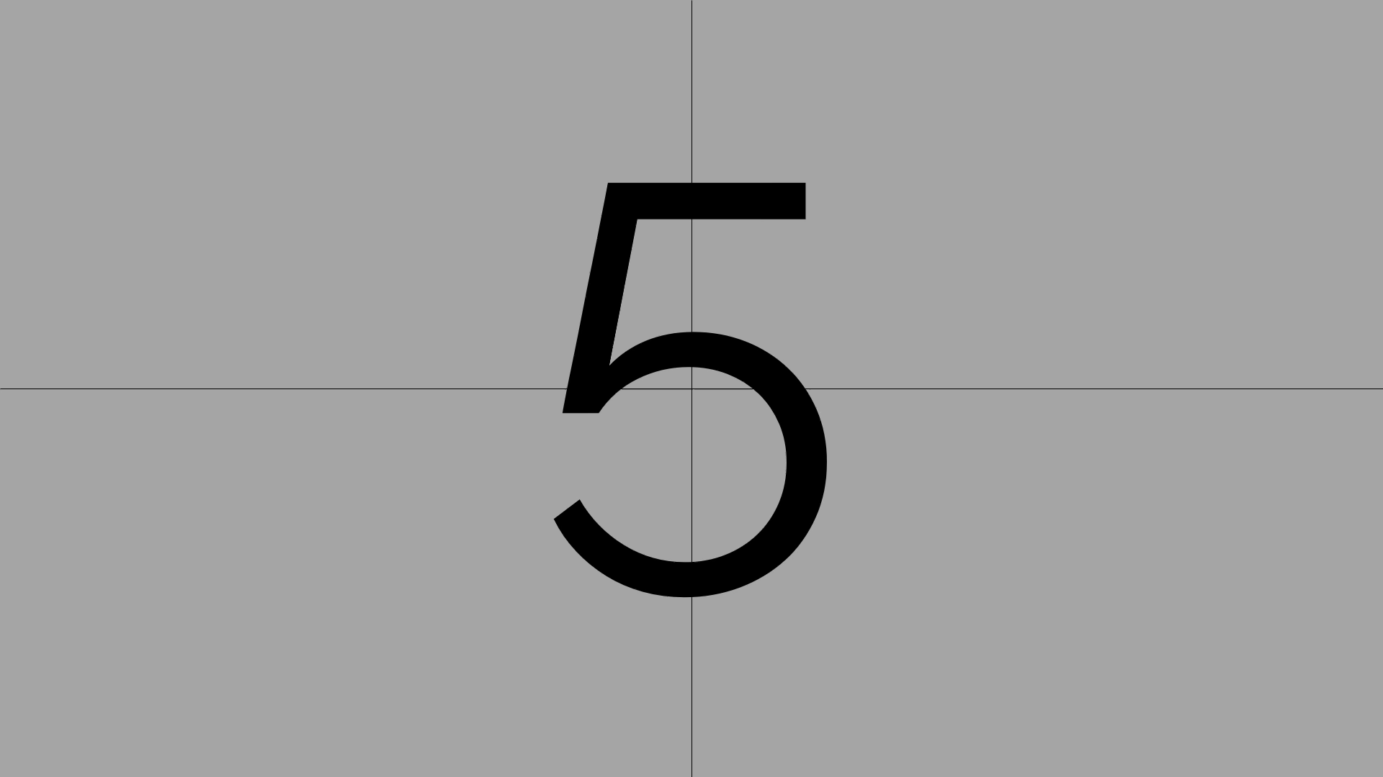

Slide 2





When Every Second Counts: Can CNN and KAN Prevent the Next Tragedy?
In drowning, every second truly counts.
Joash Alwinn Voon Dirui, Tan Hoong Guan
Tunku Abdul Rahman University of Management and Technology (TARUMT)
Bachelors in Data Science (Honours) - RDS

Slide 3

1
PROVEN AND WIDELY USED IN IMAGE RECOGNITION TASKS
📷
2
STRONG TRACK RECORD IN
COMPUTER VISION
3
MATURE MODEL WITH EXTENSIVE
RESEARCH
🧠
📚
Why CNN Was Chosen for Drowning Detection

Slide 4
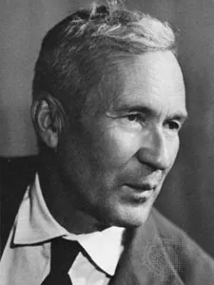
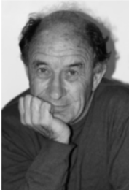
1
A NEW AND LESS EXPLORED MODEL ARCHITECTURE
📷
+
2
OFFERS PROMISING RESULTS IN INTERPRETABILITY AND PERFORMANCE
3
WANTED TO EXPERIMENT WITH SOMETHING INNOVATIVE
🧠
📚
Why KAN Was Chosen for Drowning Detection

Slide 5
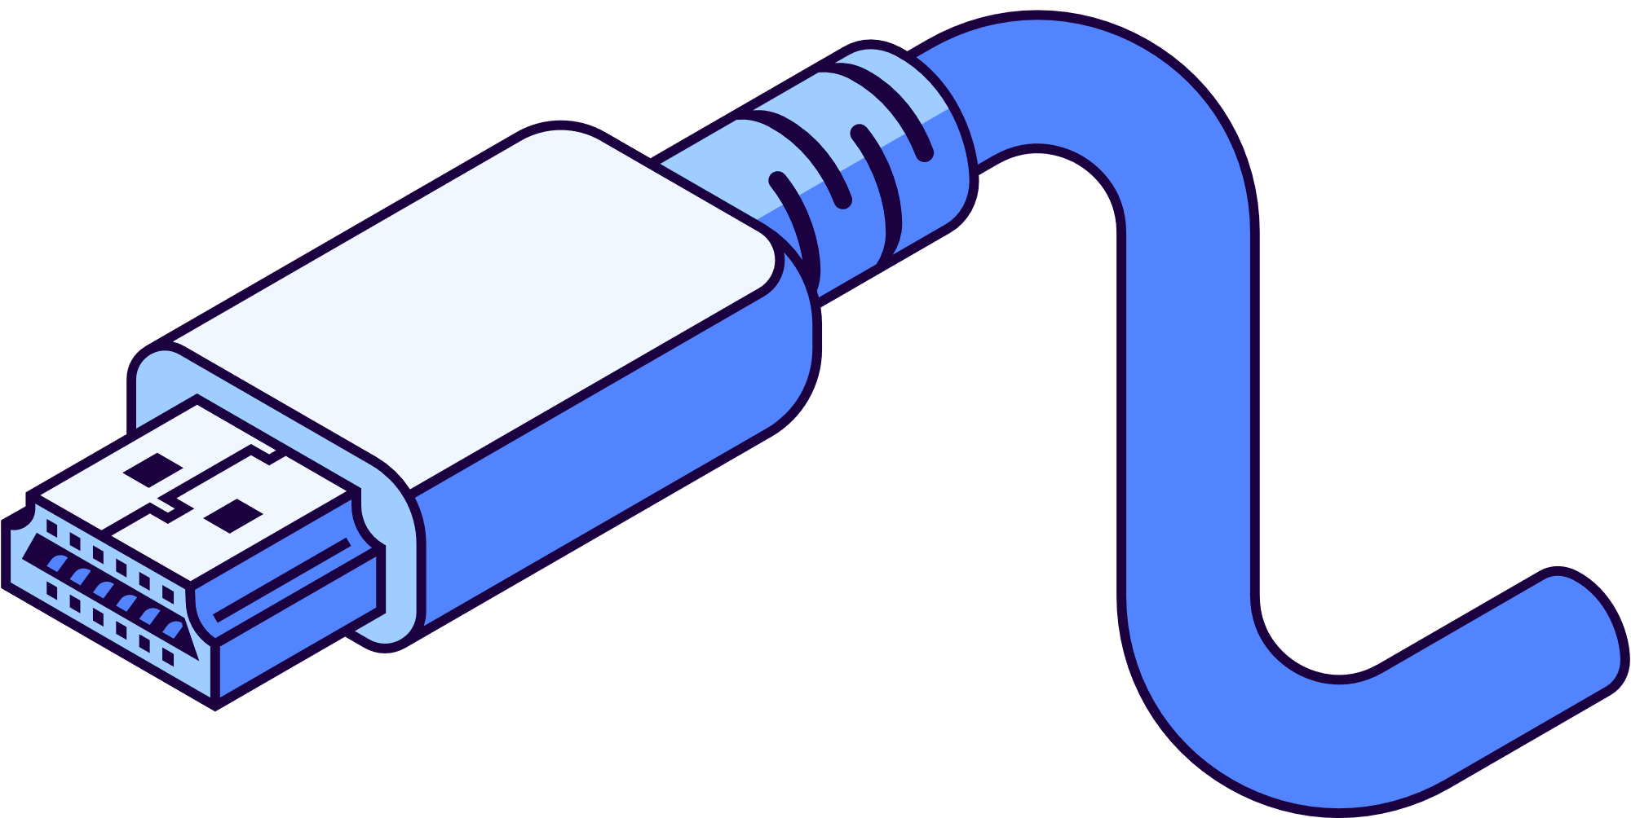
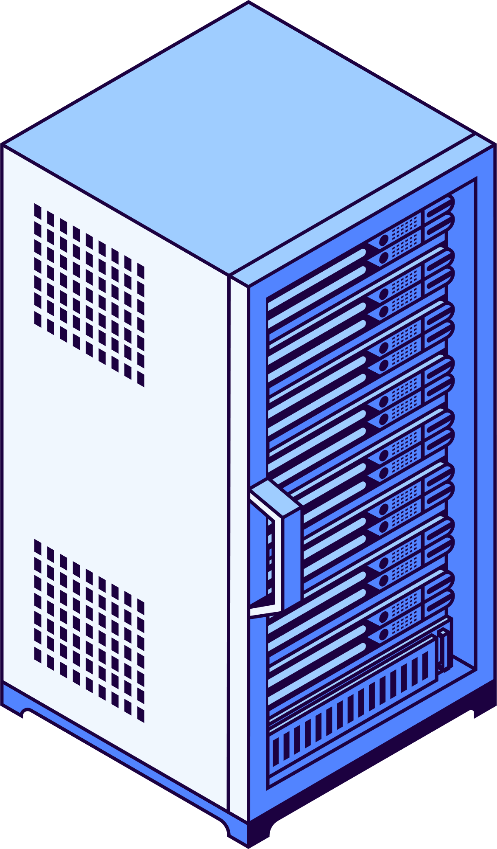
Literature Review

Slide 6
Contemporary Model | Convolutional Nerural Network (CNN) | Kolmogorov-Arnold Network (KAN)
Year Founded | 1989 (theoretical), widely adopted from 2012 | 1957 (theoretical), firstly implemented in 2023
Owner | Various implementations, popularised by researchers at University of Toronto | Vladimir Arnold and Andrey Kolmogorov - Initial implementation by Jiashun Chen and colleagues at MIT
Supported Features | Hierarchical feature extraction Transfer learning capability, well-established architectures (ResNet, VGG, etc.) Extensive community support | Learnable activation functions on the network's edges Enhancing flexibility Allowing for more complex function approximation
Common Applications | Image classification Object detection Facial recognition | Time series prediction Scientific modeling Few-shot Learning
Limitations | - Black-box behavior Dense, entangled features Generic interpretability | Relatively new with limited community support Computational complexity for large-scale applications Limited established architectures

Slide 7
Demo

Slide 8
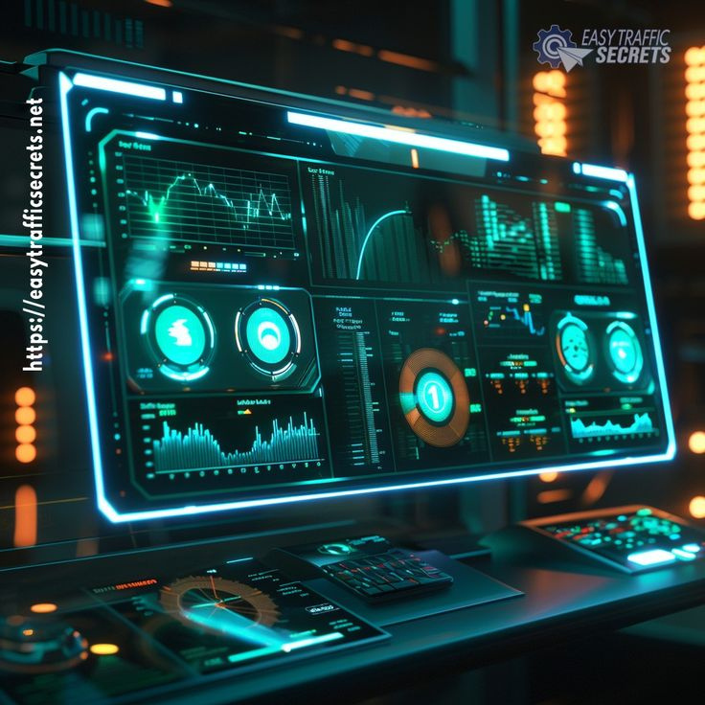
Model Performance
CNN_RGB
CNN_Grayscale
KAN_RGB
KAN_Grayscale

Slide 9
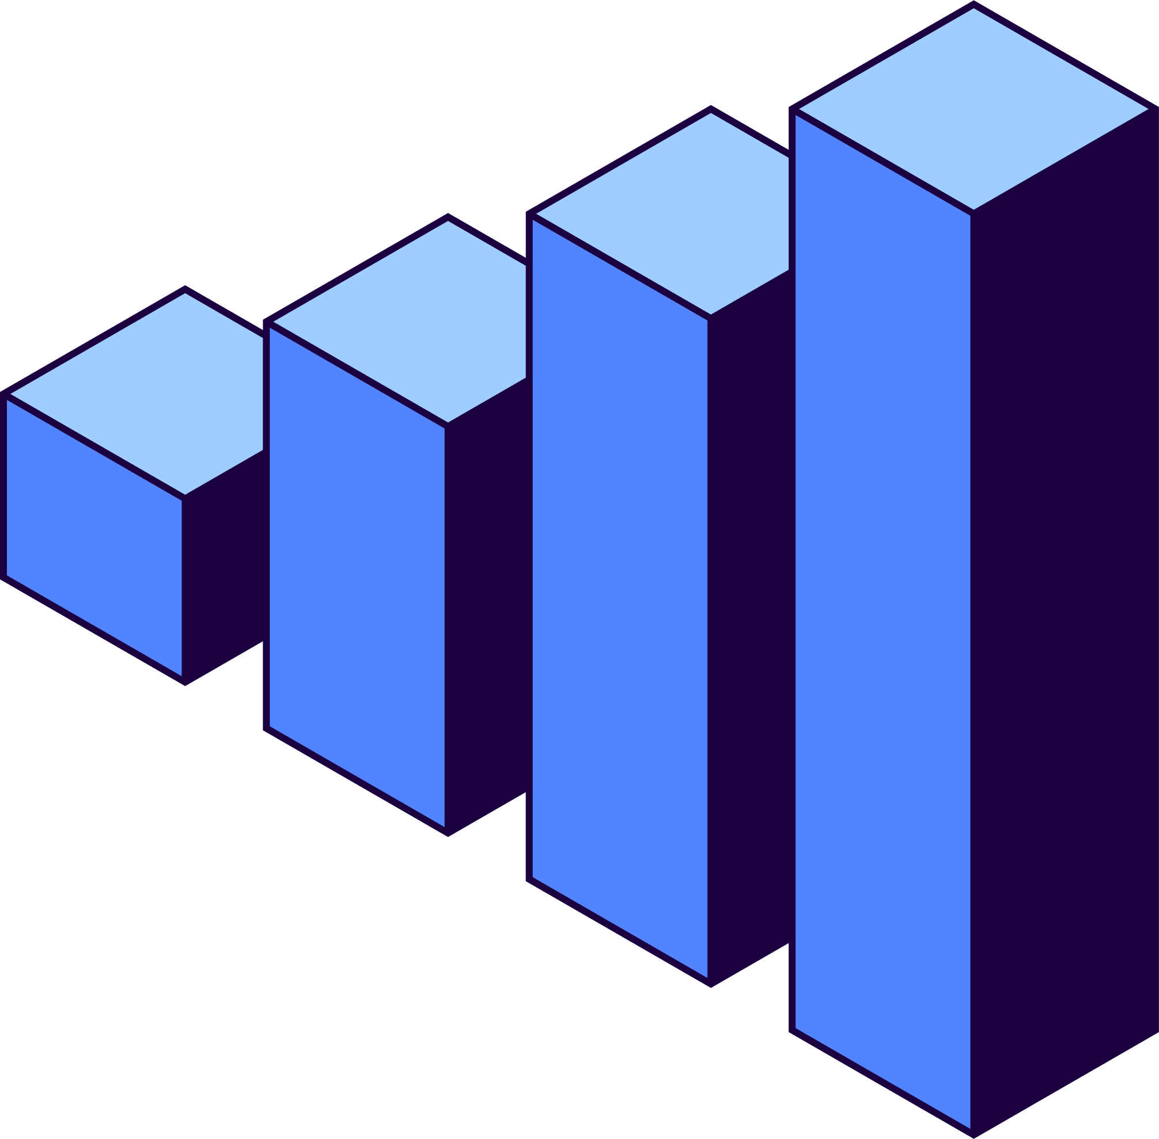
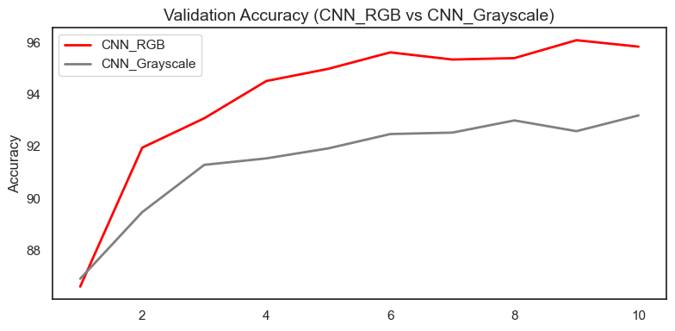
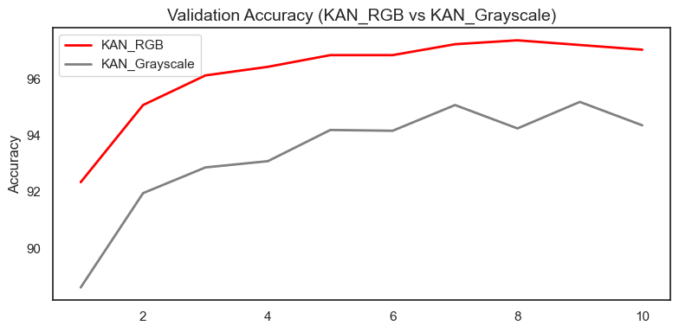
RGB vs Grayscale Input
RGB outperformed Grayscale Input
KAN_RGB: 97.37% vs. KAN_Grayscale: 95.19%
CNN_RGB: 96.30% vs. CNN_Grayscale: 93.01%

Slide 10
Model | KAN_RGB | CNN_RGB
Validation Accuracy | 97.37% (Slightly Higher) | 96.30%
Training Time | 83.11 minutes (Significantly Slower) | 5.31 minutes (Much Faster)
Inference Sped | 174.85 ms (Slower, ~5-6 FPS) | 23.50 ms (Faster, ~40-42 FPS)
Hardware: Nvidia Geforce RTX 3050

Slide 11
Conclusion
CNN Performs Best
KAN Accuracy Trade-off
CNN provides the best balance between high accuracy (>96%) and the crucial requirement for real-time processing speed.
KAN, while slightly more accurate in this study, it came at a substantial cost in terms of training time and inference speed.
CNN wins the battle!

Slide 12

Thank You!

